Slide 1
ServiceNow Portal Design Workshop
FY24
Notes:
Robert

Slide 2
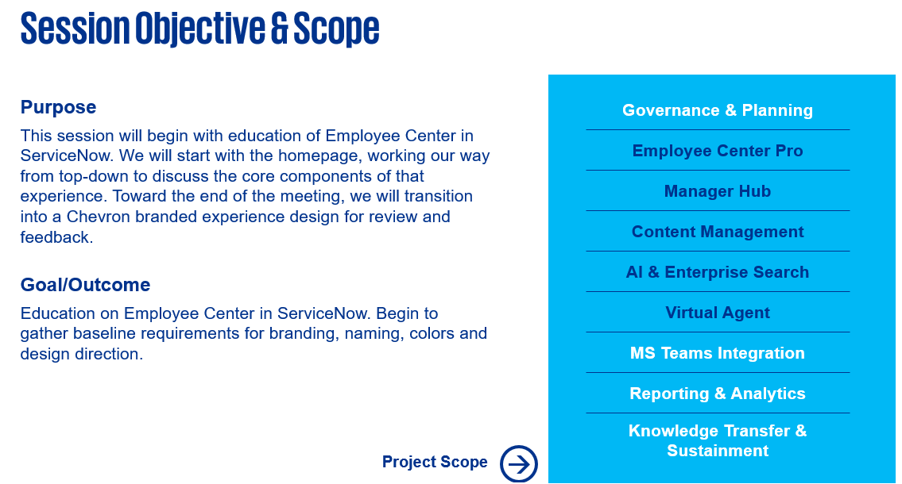
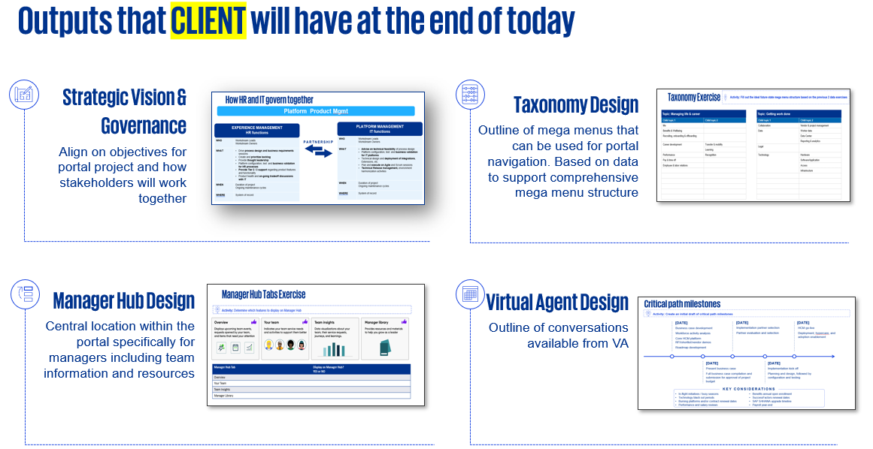
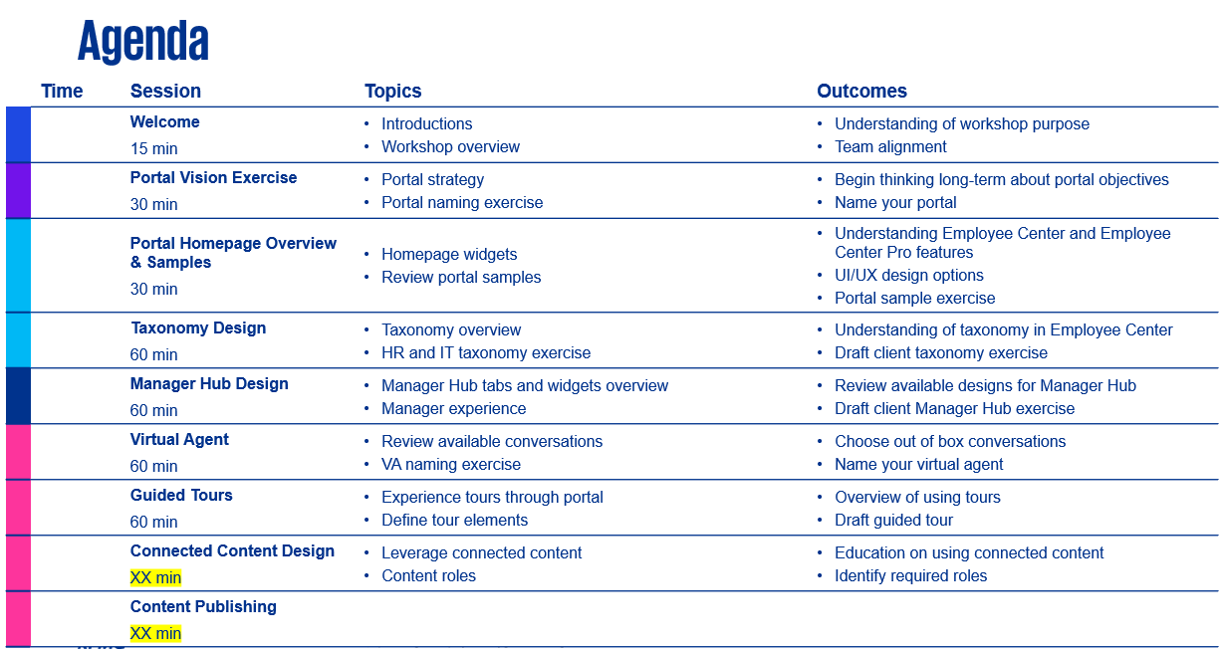
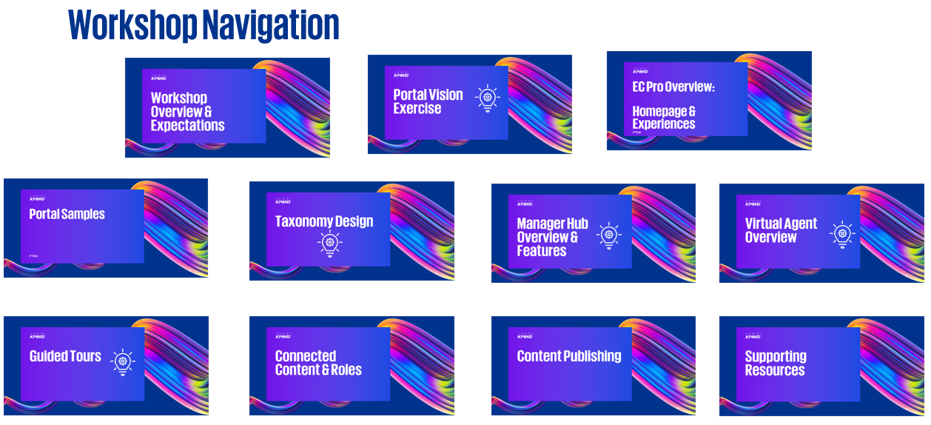
How to use this deck (REMOVE BEFORE WORKSHOP)
This deck is intended to outline all features a client should consider when implementing ServiceNow Employee Center or Employee Center Pro. Copy/edit this deck according to the topics/features your client is considering
Identify what your client needs
Choose relevant topics and slides to support what your client is looking for
Choose relevant slides based on client needs
Make a copy of this deck and rearrange slides as necessary
Consider if client is looking for art of the possible, back to box, process optimization, etc.
Update workshop navigation
Slide 4 in this deck outlines the available topics within the deck
In your copy deck, update the navigation slide based on the topics you’ll be covering
Update agenda
Slide 3 in this deck outlines a 5 hour workshop covering all topics in the deck
In your copy deck, update the agenda slide based on the topics you’ll be covering
Be sure to include time for breaks and lunch where necessary

Slide 3
Agenda
 | Time | Session | Topics | Outcomes
 | 9:00 am | Welcome 15 min | Introductions Workshop overview | Understanding of workshop purpose Team alignment
 | 9:15 - 9:45 am | Portal Vision Exercise 30 min | Portal strategy Portal naming exercise | Begin thinking long-term about portal objectives Name your portal
 | 9:45 – 10:15 am | Portal Homepage Overview & Samples 30 min | Homepage widgets Review portal samples | Understanding Employee Center and Employee Center Pro features UI/UX design options Portal sample exercise
 | 10:15 – 10:30 am | Break 5 min
 | 10:30 – 11: 30 am | Taxonomy Design 60 min | Taxonomy overview HR and IT taxonomy exercise | Understanding of taxonomy in Employee Center Draft client taxonomy exercise
 | 11:30 – 12:15 pm | Lunch 60 min
 | 12:15 – 1:15 pm | Manager Hub Design 60 min | Manager Hub tabs and widgets overview Manager experience | Review available designs for Manager Hub Draft client Manager Hub exercise
 | 1:15 – 2:15 pm | Virtual Agent 60 min | Review available conversations VA naming exercise | Choose out of box conversations Name your virtual agent
 | 2:15 – 2:30 pm | Break 15 min
 | 2:30 – 3:30 pm | Guided Tours 60 min | Experience tours through portal Define tour elements | Overview of using tours Draft guided tour
 | As time permits | Connected Content Design XX min | Leverage connected content Content roles | Education on using connected content Identify required roles
 | As time permits | Content Publishing XX min

Slide 4






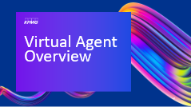





Workshop Navigation

Slide 5

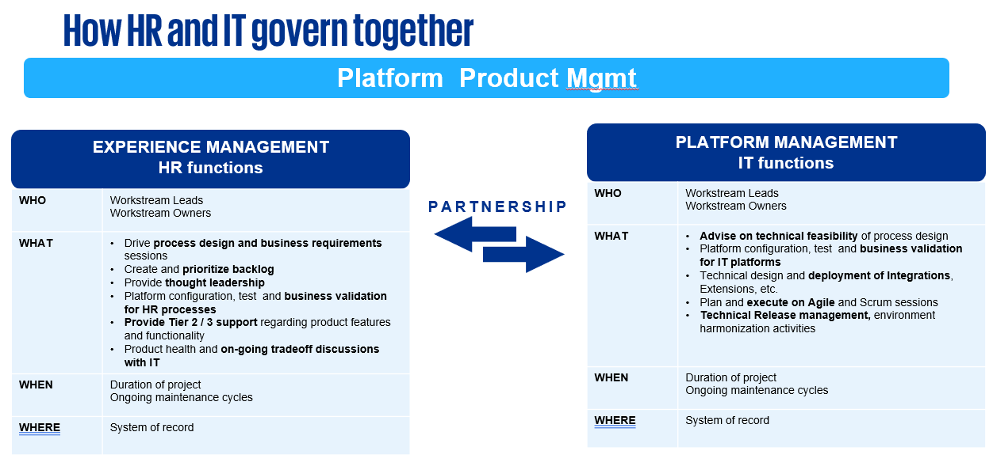
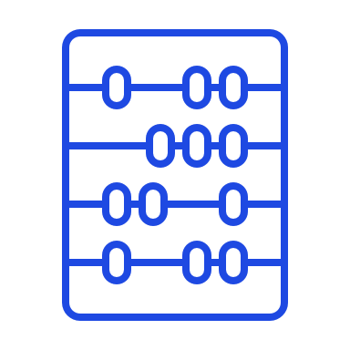
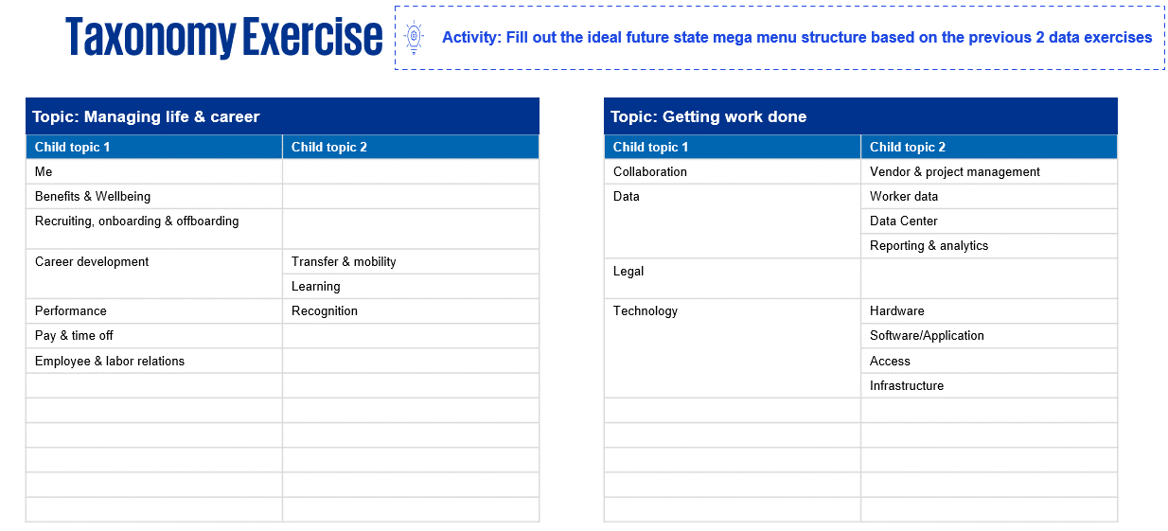

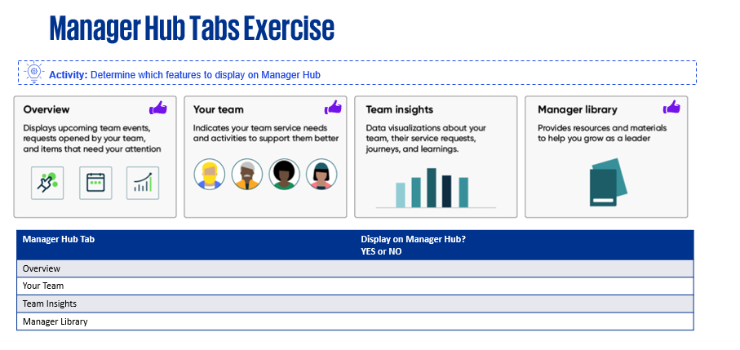

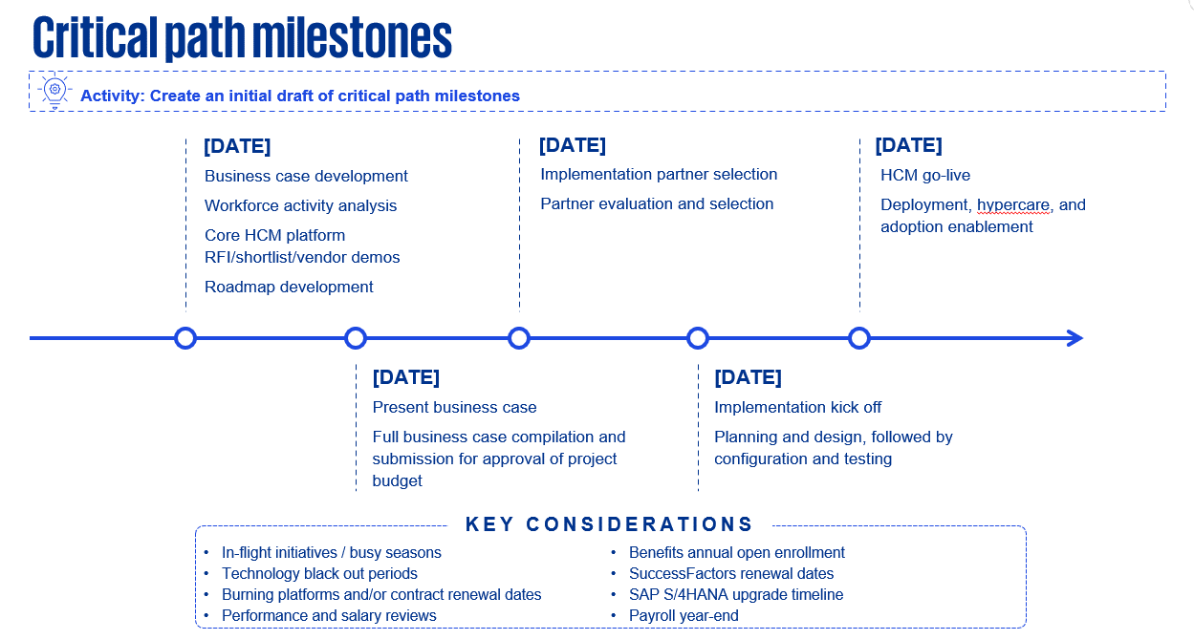
Outputs that CLIENT will have at the end of today
Strategic Vision & Governance
Align on objectives for portal project and how stakeholders will work together
Taxonomy Design
Outline of mega menus that can be used for portal navigation. Based on data to support comprehensive mega menu structure
Manager Hub Design
Central location within the portal specifically for managers including team information and resources
Virtual Agent Design
Outline of conversations available from VA

Slide 6
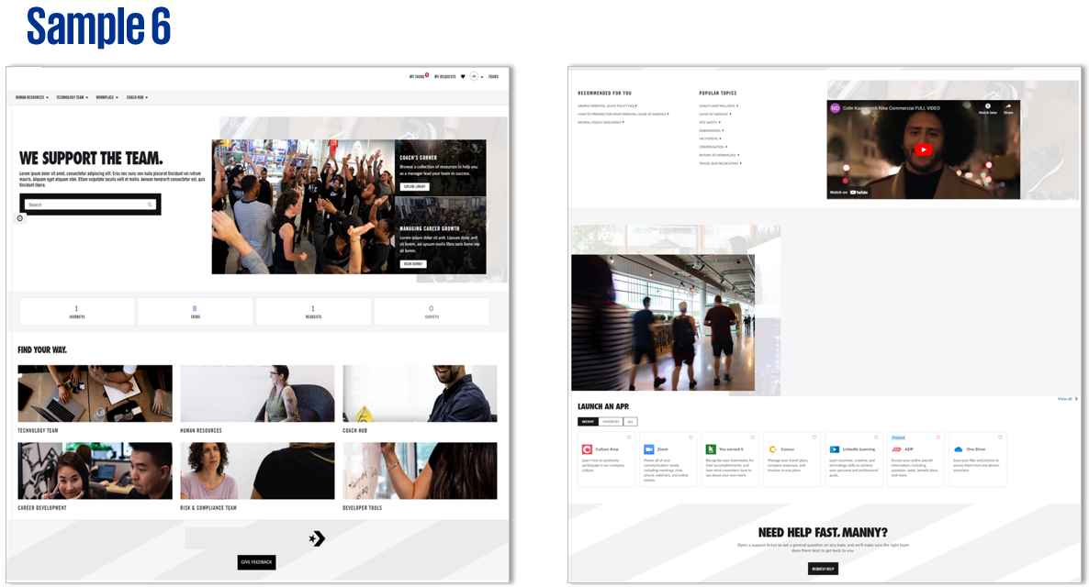
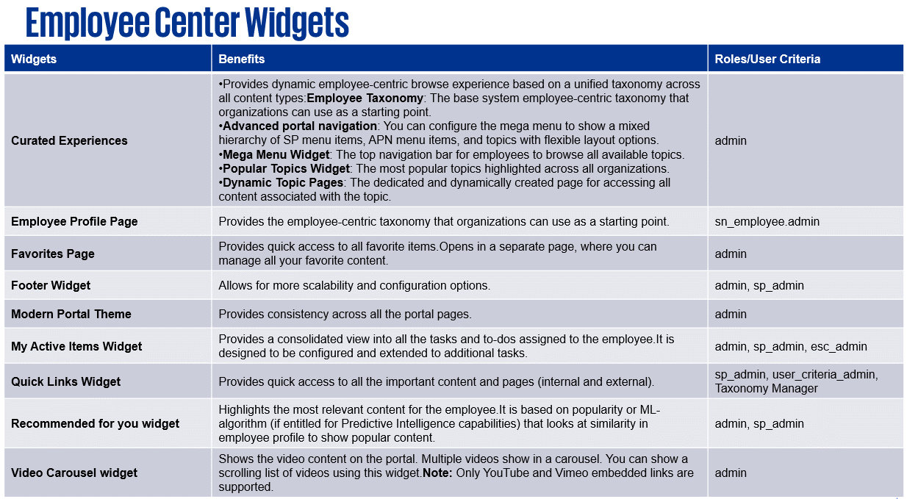
Supporting Resources that CLIENT will have at the end of today
Portal Samples
Portal designs completed for various clients to assist with future visioning sessions
Widget Library
List of all available widgets that can be configured in EC Pro including technical details.

Slide 7
Workshop Overview & Expectations

Slide 8
Session Objective & Scope
Purpose
This session will begin with education of Employee Center in ServiceNow. We will start with the homepage, working our way from top-down to discuss the core components of that experience. Toward the end of the meeting, we will transition into a Chevron branded experience design for review and feedback.
Governance & Planning
Employee Center Pro
Manager Hub
Content Management
AI & Enterprise Search
Goal/Outcome
Education on Employee Center in ServiceNow. Begin to gather baseline requirements for branding, naming, colors and design direction.
Virtual Agent
MS Teams Integration
Reporting & Analytics
Knowledge Transfer & Sustainment
Workshop Scope
→

Slide 9



Workshop Expectations
01
02
03
04
Participate actively during the workshop.
Ensure future state design of the workforce experience and address current issues and pain points. Be harmonized and streamline across the business and utilize the full potential of ServiceNow’s functionality.
Ensure future state design of the workforce experience and address current issues and pain points. Be harmonized and streamline across the business and utilize the full potential of ServiceNow’s functionality.
Provide an understanding of any compliance regulations that will be required for the function you are representing.
Open mindedness about how work will be done in the future. Wear an enterprise-wide hat and are willing to try new things!

Slide 10
Workshop Guiding Principles
Don’t lose sight of the goal! Focus on capturing data that will increase platform capabilities and streamline processes. | Use what ServiceNow brings and adjust the business before adjusting the platform. Stick to the baseline. | Follow the 80/20 rule. What decisions will accommodate 80% of your situations. Don’t let exceptions derail the entire discussion and process. | Utilize rapid prototyping and iterative development to review and test the system to catch problems early on.
Information Security Carefully consider who needs access to sensitive information. | Don’t ignore or avoid difficult decisions. Escalate when needed. Embrace change. | Challenge current practice and drive value by eliminating pain points. | Strive for standardization. Focus on configuration, not customization. Exceptions should be approved.

Slide 11
How HR and IT govern together
Platform Product Mgmt
EXPERIENCE MANAGEMENT
HR functions
PLATFORM MANAGEMENT
IT functions
WHO | Workstream Leads Workstream Owners
WHAT | Drive process design and business requirements sessions Create and prioritize backlog Provide thought leadership Platform configuration, test and business validation for HR processes Provide Tier 2 / 3 support regarding product features and functionality Product health and on-going tradeoff discussions with IT
WHEN | Duration of project Ongoing maintenance cycles
WHERE | System of record
WHO | Workstream Leads Workstream Owners
WHAT | Advise on technical feasibility of process design Platform configuration, test and business validation for IT platforms Technical design and deployment of Integrations, Extensions, etc. Plan and execute on Agile and Scrum sessions Technical Release management, environment harmonization activities
WHEN | Duration of project Ongoing maintenance cycles
WHERE | System of record
PARTNERSHIP

Slide 12
How HR and IT govern together
Project Management
EXPERIENCE MANAGEMENT
HR functions
PLATFORM MANAGEMENT
IT functions
WHO | Workstream Leads Workstream Owners
WHAT | Share HR vision for workforce priorities and strategy Set program priorities in the context of workforce experience Align expectations of HR stakeholders with platform capabilities Partner with the IT Workstream Leads to develop Program and Product strategy and roadmap
WHEN | Duration of project Ongoing maintenance cycles
WHERE | System of record
WHO | Workstream Leads Workstream Owners
WHAT | Engage HR to understand their vision, priorities, outcomes, pain points Provide Technical point of view on feasible solution options, scoping, sizing, and art of the possible. Partner with the HR Workstream Leads to develop Program and Product strategy and roadmap
WHEN | Duration of project Ongoing maintenance cycles
WHERE | System of record
PARTNERSHIP

Slide 13
How HR and IT govern together
Employee Experience Management
EXPERIENCE MANAGEMENT
HR functions
PLATFORM MANAGEMENT
IT functions
WHO | Workstream Leads Workstream Owners
WHAT | Design end to end business processes that support experiences for all personas in scope. Partner with the IT Workstream Lead and Owners to explore platform-based solution options and technical feasibility Complete requirements validations Prepare for adoption with change impact assessment and readiness
WHEN | Duration of project Ongoing maintenance cycles
WHERE | System of record
WHO | Workstream Leads Workstream Owners
WHAT | Partner with the HR Workstream Lead and Owners to advise on technical feasibility and platform solution Design wire frames and build prototypes to demonstrate what the experience would look like Plan and execute Agile and Scrum sessions, groom backlog, etc.
WHEN | Duration of project Ongoing maintenance cycles
WHERE | System of record
PARTNERSHIP

Slide 14
Portal Vision Exercise

Slide 15



Strategic Visioning
Potential vision for both the short-term and long-term workforce experience.
What is the long-term vision for this experience?
Why are we doing this and who is feeling the impact?
What is the ultimate outcome we want to achieve?
3 clicks to happiness
Unified experience for common (CLIENT) journey
Consumer-grade integrated experience
Employees are able to complete actions on their own (Intuitive, no training needed)
One stop shop
Effective self-service
Personalized experience
Employees, Managers, New Hires
Contractors, Part-time, Alumni
Everyone who engages with back office
Employees to focus on working safely
Remove barriers for new employees
Reduce load on support teams
Reduce frustrations of end users
Save people’s time
Too much interdependency between too many platforms, portals
Support team
Higher returns
Better employee experience
More time for strategic activities (things that matter)
Simplified processes
Unburdened customers
Improved productivity
Employee retention
Customers get what they need and don't need to know who's doing it
Satisfied employees
Sustainable, scalable solution that grows with us
Reliable and efficient service delivery

Slide 16

Leading Practices for Employee Center
Focus on the branding, fonts, color palette and layout to ensure core Employee Center components are in line with your company’s brand standards.
1
Imagery adds value. Begin getting approved stock images and icons together as early as possible.
2
Make searching and navigation easy through a well-defined, worker-friendly taxonomy structure.
3
Focus on improving native capabilities through design, without altering functionality. Refer to the out-of-the-box before creating custom.
4

Slide 17

EC Portal Name Voting Exercise
Activity: Use the below link to submit your response. Consider names or phrases that would resonate with employees.
Below are some current ideas for our EC Portal name:
MyChevron
ChevronPortal
MyPortal
ChevronCentral
ChevronCenter
ChevronCorner
ChevronHub
MyHub
POLL EV QR CODE

Slide 18
EC Pro Overview: Homepage & Experiences
FY24
Notes:
Robert

Slide 19
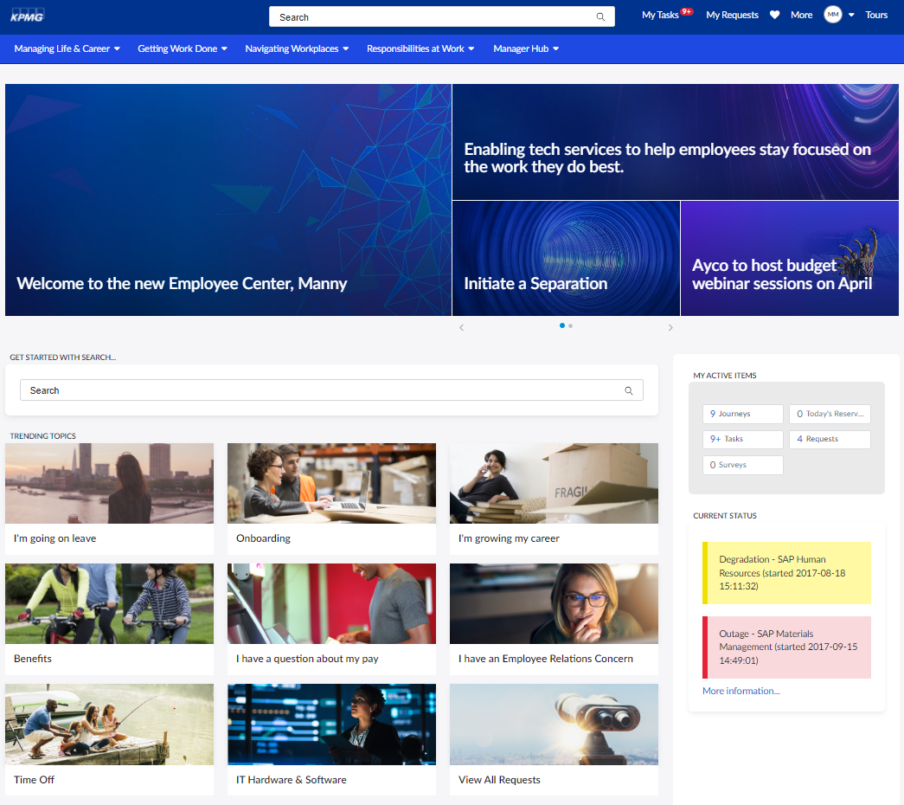
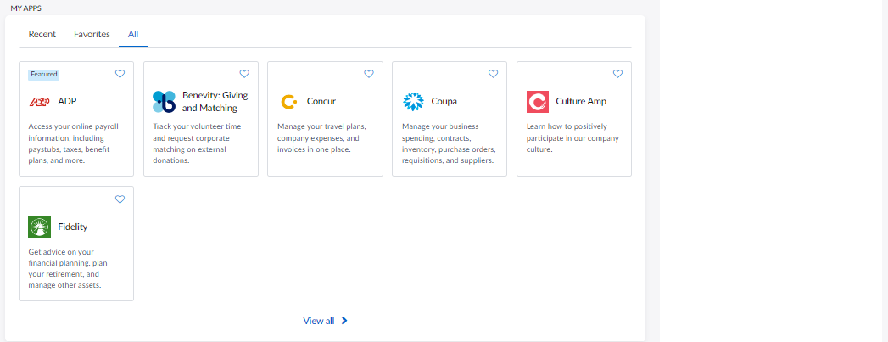

Employee center components
ServiceNow employee center provides a multi-departmental portal so employees stay engaged, productive, and informed, and can request services easily.
Key Considerations
Landing Pages
Logo and color scheme
Background imagery
Contextual search
Placement of widgets
Linking to content
Submitting new cases
Campaigns
Configurable template to align with your branding and style guide across the enterprise.
Header & Mega Menu
Drive employee experience and engagement with quick access to frequent favorites including My Career, My Work, My Applications, HR, IT and Knowledge Bases.
Widgets
Configurable plug-ins used to provide quick access to information.
MTM
Featured Articles
My Requests
My Active Items
My Tasks
Videos
Upcoming Events

Slide 20
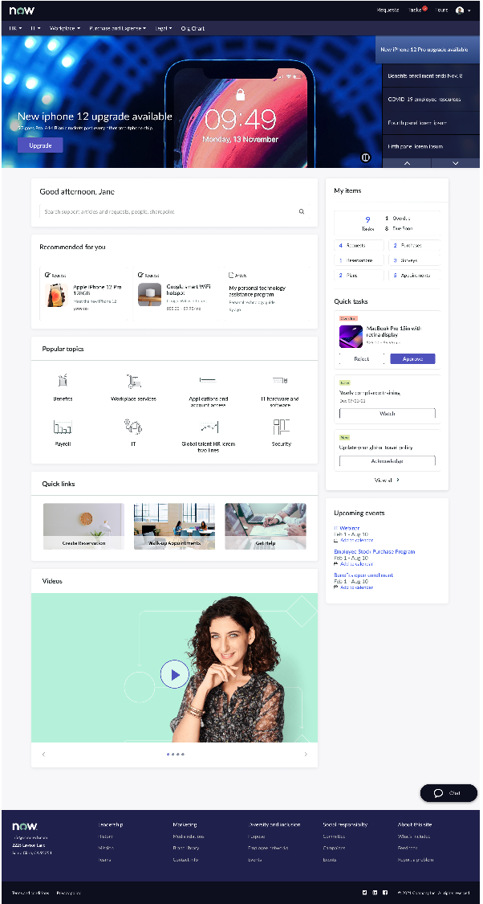
Employee Center Pro acts as a worker destination site
Enhances the Employee Center Portal to include worker engagement and communication use cases. It can serve as a Modern Intranet Site and encourages portal consolidation.
It includes:
Actionable, targeted campaigns
Dynamic topic pages for popular topics
Specialized widgets for multi-department tasking
Advanced search
Machine learning and AI

Slide 21
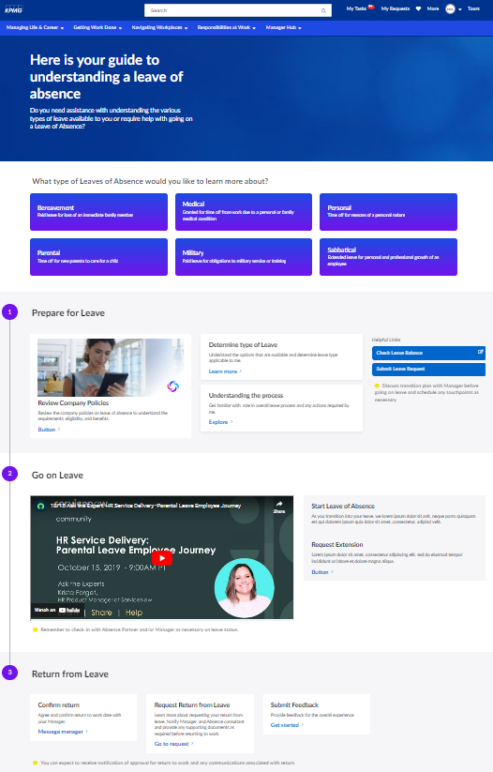
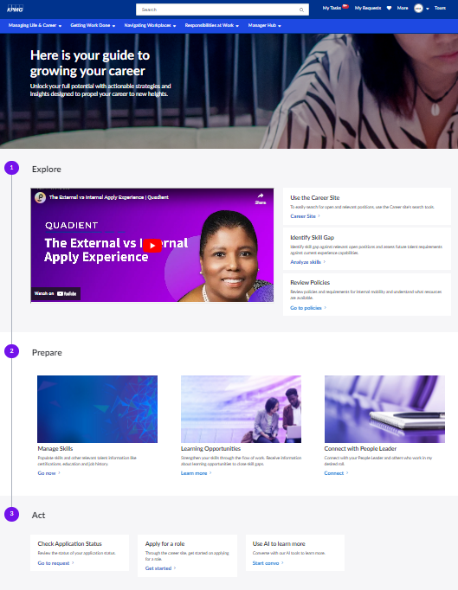
Digital experiences
Creating an engaging digital employee experience from the prioritized Moments-That-Matter requires a human-centered, connected experience across platforms and systems delivered “in the flow of work”.
Key Considerations
Logo and color scheme
Background imagery
Contextual search
Placement of widgets
Linking to content
Submitting new cases
Campaigns
Landing Pages
Configurable template to align with your branding and style guide across the enterprise.
Widgets
Configurable plug-ins used to provide quick access to information.
MTM
Featured Articles
My Requests
My Active Items
My Tasks
Videos
Upcoming Events
Etc…

Slide 22
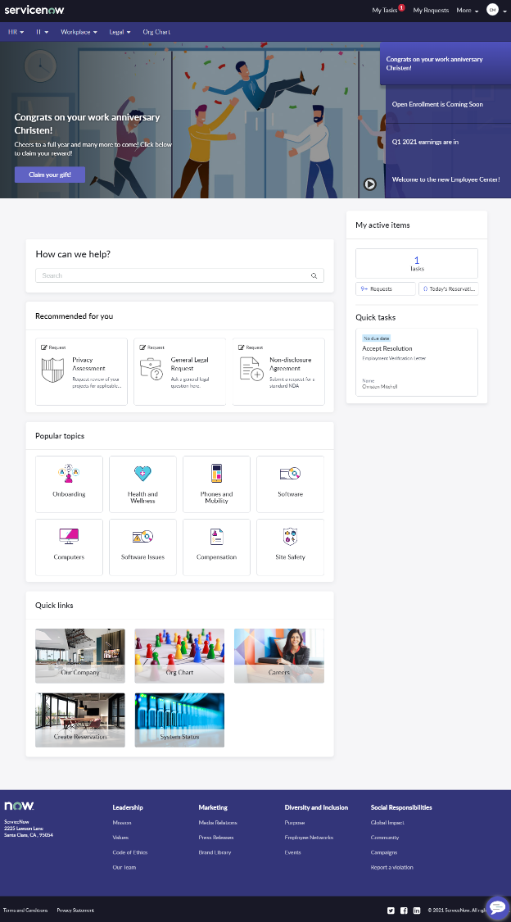
Employee Center Pro Home Page
1
2
3
4
Employee Center (EC) provides a best-in-class portal home page with all the relevant widgets for an employee-centric experience. The EC home page can be configured to suit your organization’s needs.
Widgets included on the home page:
Employee Center Header
Mega Menu
Org Chart
Content Experiences
Homepage Search
My Active Items
Recommended for You
Popular Topics
Quick Links
Employee Center Footer
6
5
7
8
9
10
Notes:
In this section, we’ll review the widgets in more detail

Slide 23
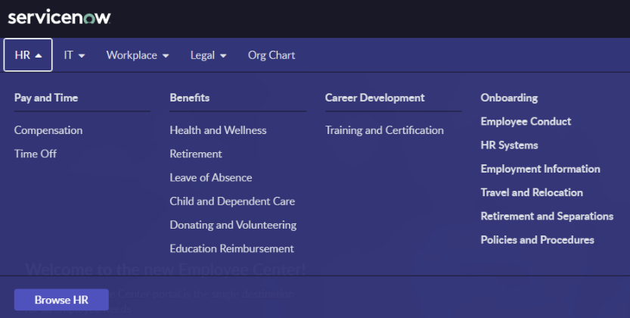
HR Taxonomy
HR
Pay and Time
Benefits
Career Development
Onboarding
Employee Conduct
HR Systems
Return to Workplace
Employment Information
Travel and Relocation
Retirement and Separation
Policies and Procedures
Compensation
Time Cards
Tax Information
Time Off
Health and Wellness
Retirement
Leave of Absence
Child and Dependent Care
Donating and Volunteering
Education Reimbursement
Promotions
Job Change
Career Growth
Training and Certification
Talent Management
Performance
Mega Menu
Notes:
Note: Topics must have connected content in order to appear in the Mega Menu
Content can be mapped to more than one topic (for example: a knowledge article about workplace safety guidelines could be connected to the Workplace > Site Safety topic and HR > Return to Workplace topic

Slide 24
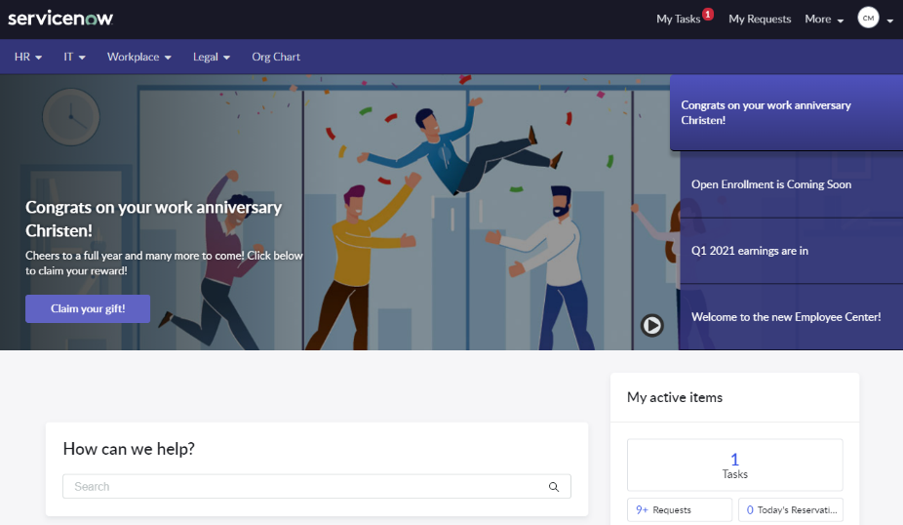
Homepage Search Widget
The Homepage Search widget adds a search bar to home page.
The standard title that appears above the search bar is “How can we help?” but can be configured
A subtitle can also be added to appear below the title
The default text within the search bar can be updated and styled using the options in the Typeahead Search widget (e.g., color, size, etc.)

Slide 25
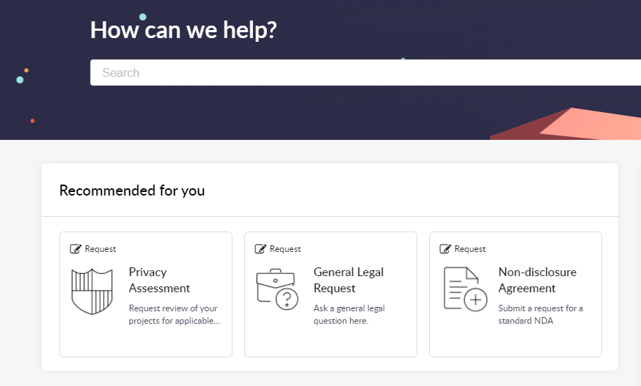
Recommended for You Widget
The Recommended for You widget combines content types (Catalog Items and Knowledge articles) into single list view enabling you to view information that is most relevant to you.
The widget can be configured to update:
The title – something employee’s will recognize easily
Number of items to display – consider key items and number of items to show
The category of items to display – select from knowledge, catalog or both
List type – show items in a card view or simple list view (default)
Note: For HR, content is recommended based on HR profile. For other areas, content is recommended based on popularity
Notes:
Taxonomy takes precedence over directly associated SC/KB's sources with portal record. Recommend engine runs on either of these content sources.
Notes on the Recommended for You algorithm:
For HR Pro customers: Content is recommended based on user profile similarity algorithm. No change to existing algorithm.
For all other customers: Recommendation score is calculated by popularity of content (i.e., number of views on KB article and number of requests submitted for a catalog item).

Slide 26
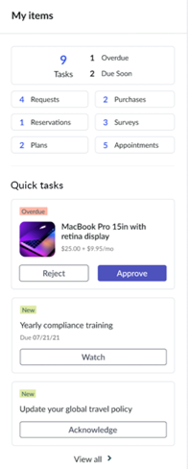
My Active Items Widget
The My Active Items widget displays a summary view of a user’s open activities across departments.
Activities can include tasks, requests, surveys, reservations
Each activity type shows a count of open items
The Quick tasks section is an expanded list of records for top, or primary, activity
Default options include:
Tasks – links to the To-dos page (My Tasks)
Requests – links to Requests page (My Requests)
Additional activities can be configured using the Activity Configuration.
Notes:
A portal widget that shows all user active activities at one place.
One can specify various filter conditions to the selected table and mention page link on the portal or external links that will be used for navigation when a user clicks on the summary or view all link in the list view.

Slide 27
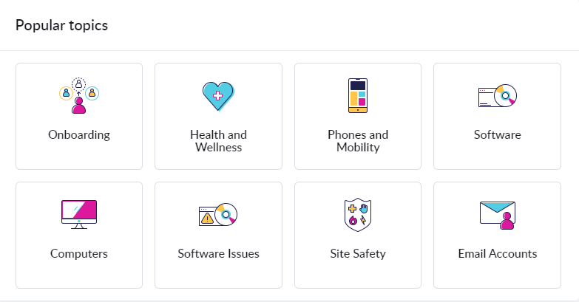
Popular Topics Widget
Quickly see and access the most viewed topics using the Popular Topics widget on the Employee Center home page.
Configurable options that can be updated:
Title – If renaming, make it easy to understand
Number of topics – Consider how many items to display
Display size of card tiles – Consider size in relation to other content and amount of available space on home page
Border color – Draw attention to this widget using color
Note: Popularity is calculated across the Taxonomy structure to shows most viewed topics. The popularity of a topic is the aggregation of the popularity of all the content under that particular topic.
Notes:
This widget is automatically enabled as the part of the EC home page.
Note: Content taxonomy needs to be associated with the portal

Slide 28
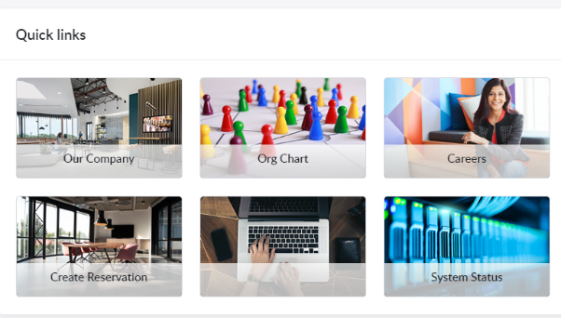
Quick Link Widget
Easily access important internal and external resources related to specific departments within your organization
Supported links
Service Catalog
KB article
Portal Page
External URL
Admins can control visibility of the links by using user criteria on the quick links as well as on the underlying object (i.e., home page or topic page)
Notes:
Widget is automatically enabled on EC home page and topic pages. For it to be visible, customers would need to Add records to the quick link table and then associate to widget instance.
For quick links to pop-up on the topic pages, you need to associate it to at least one topic.
Note: this widget is different from the quick links widget available as part of content delivery

Slide 29
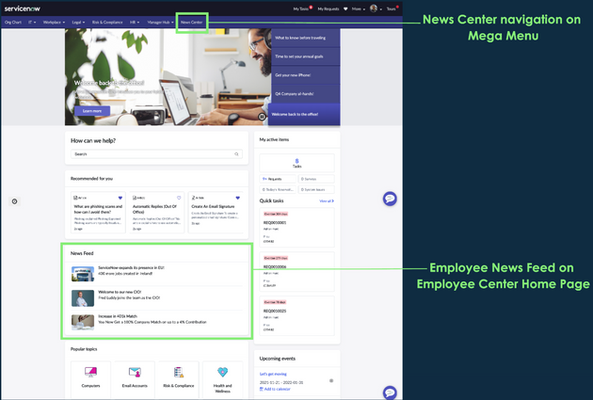
News Feed
A new featured news page widget is available for the Employee Center homepage to display news articles right on the landing page.
Content authors can effortlessly create and publish news articles using the new content type called ‘News Article’ in the existing Content Library.
All the authoring and publishing capabilities available with Content Library, such as governance, translations, and scheduling, are also applicable to News

Slide 30
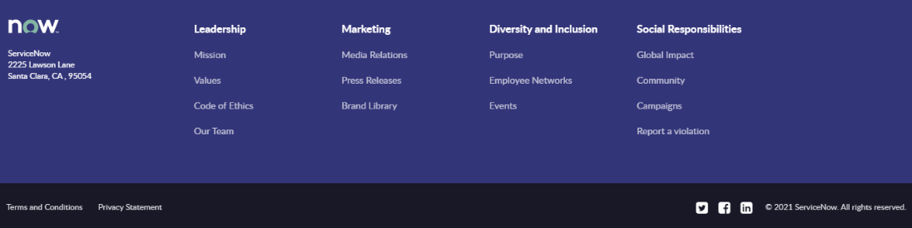
Footer Widget
Share company information and links to company resources using the Footer widget displayed at the bottom of all Employee Center pages.
Includes
Company logo and contact info
Social icon links
Links to privacy and legal statements
Copyright statement

Slide 31
Portal Samples
FY24
Notes:
Robert

Slide 32
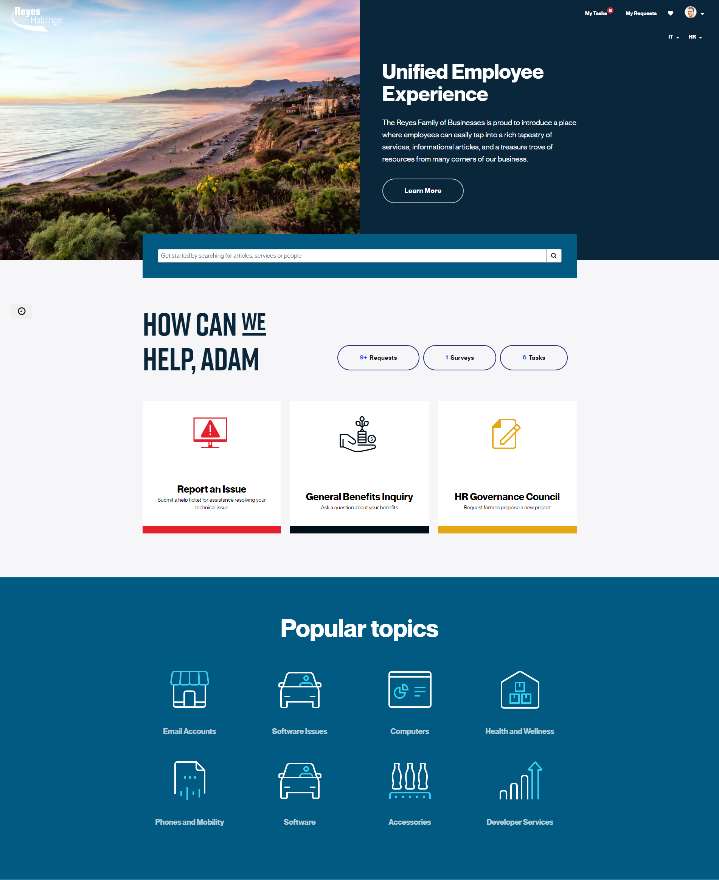
Sample 1
Design Considerations
The Company
Header: Rotating pictures of client locations, people, etc
Search: Central on the page, custom search greeting
Actions: Central on the page, personalized welcome
Popular Topics: Based on trending searches
What we like | What could be better

Slide 33
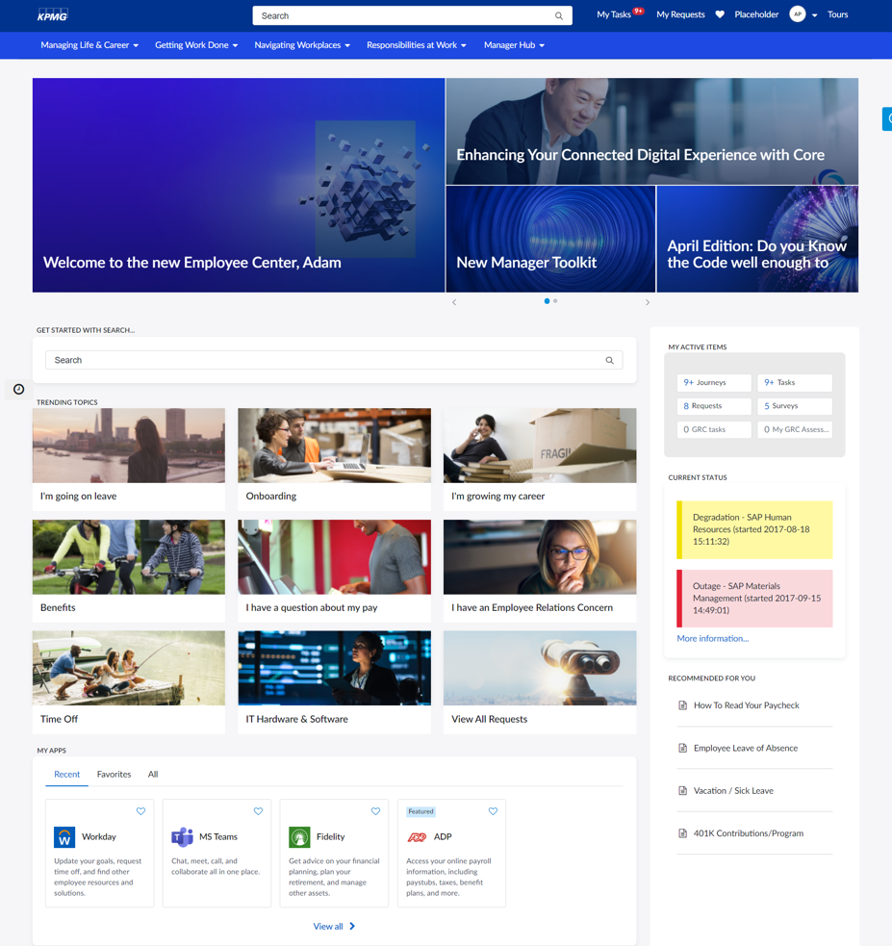
Sample 2
Design Considerations
Mega Menu: Phrases vs. Department names
Trending Topics: Central on the page, employee moments that matter
My Apps: Central on the page, connectivity to other systems
Actions: Right side bar, less central
What we like | What could be better

Slide 34
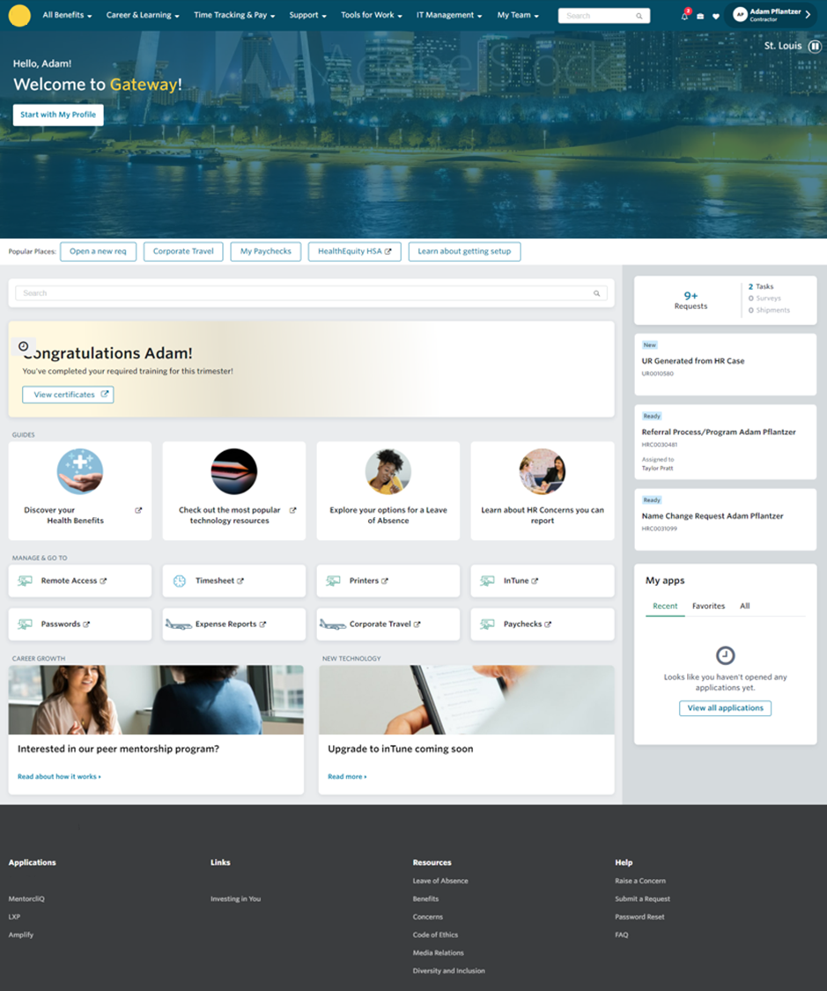
Sample 3
Company
Design Considerations
Mega Menu: Phrases vs. Department names
Trending Topics: Central on the page, employee moments that matter
My Apps: Central on the page, connectivity to other systems
Actions: Right side bar, less central
What we like | What could be better

Slide 35
Taxonomy Design

Slide 36
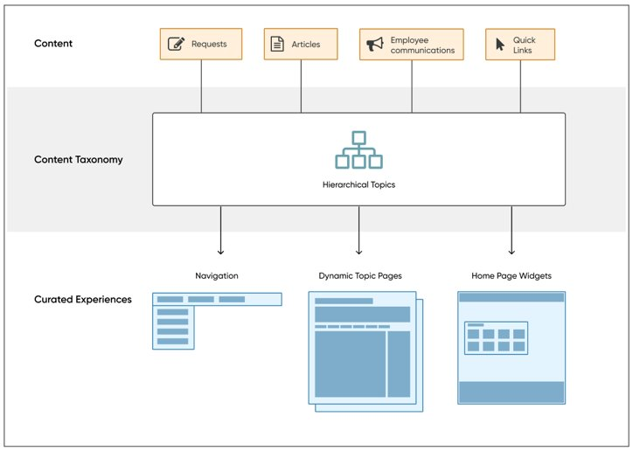
Employee Center Unified Taxonomy drives the experience
Employee Center Unified Taxonomy is the hierarchical categorization of all the content within the EC.
Contains topics which can be related to other topics in a Parent-Child relationship to form a hierarchy.
Topics are displayed through the Mega Menu, which stays with the user wherever they go in the portal.
All active content (catalog item/request, knowledge article, quick link, employee communication) should fit under a topic.
Topics can be hidden for certain user using user criteria.

Slide 37
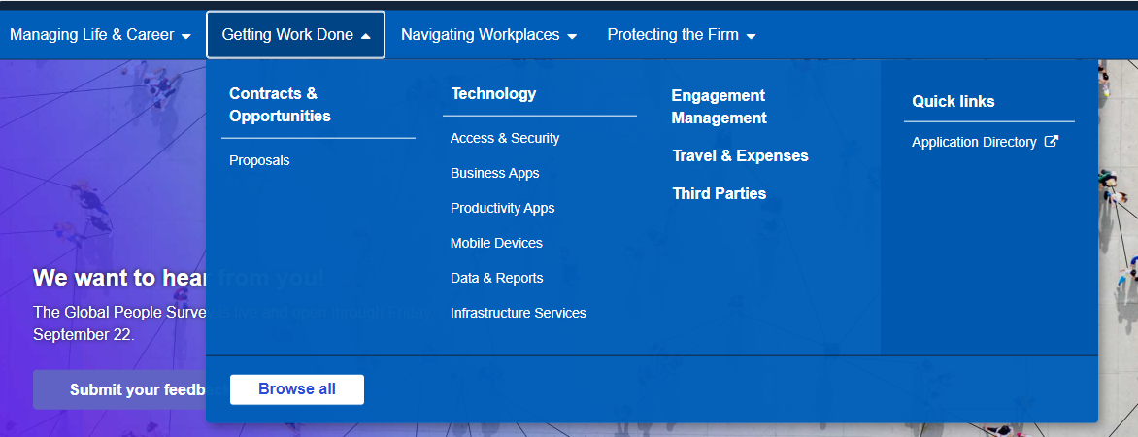
Unified Taxonomy comes to life through Mega Menu
The Mega Menu brings all the content together and allows workers to easily navigate through different topics within HR and IT, taking them where they need to be without clicking through pages of information.
Topic (top-level)
HR
IT
Topic (child topic 1)
benefits
hardware
Topic (child topic 2)
health
computers
Topic | Quick Link
Container for multiple pieces of content | Link to individual pieces of content
Visibility is controlled by the “connected content” | Visibility is conditional and can be defined
Having too many levels down may impact the way topics are displayed in the drop-down | Only visible in the Mega Menu if they tied to the top-level topic, otherwise only show on the associated topics page
Clicking on a topic under Mega Menu will take user to the topic page that has its “connected content” | Can link to catalog items and knowledge articles within ServiceNow or external pages (e.g., Workday, Degreed, etc.)
Best practices
Keep the number of top-level topics to 8-10
Nest topics 2-3 levels deep only
Consider consolidating child topic with less than 8 content items with another topic
Topic naming convention should be simple & user-centric
Categories and topics don’t have to be a 1:1 match
Not all content items need to be mapped to topics (will only show in Search)

Slide 38





IT Data to inform decision
Activity: Fill in the required data for the below topics. Use IT data to support.
Top Search Queries | Volume
SAP
Internet
USB
Security
ITSM
Sharepoint
App Support
Top Knowledge Articles | Volume
Virtual Workspace
Passwords
Desktop Support
SAP Support
Top Service Catalog Items | Volume
General IT Request
App Support Request
Internet Access Request
Password Reset
Send as part of pre-workshop data request // workshop pre-read. Ask client to complete this slide with relevant IT data. Include client’s updated slide in the workshop presentation.
Most Viewed Pages | Volume
Service Catalog
Service Portal
Knowledge Base
Walk-up / Check-in
Contact Info
Search
Report Issue
Top VA Topics | Volume
IT Issues
IT Self-Service
Request Something
Desktop Support
Check Ticket Status
Outlook / Email Issue

Slide 39
IT Current State
Keep | Data shows that employees use this topic regularly
Remove | Data shows employees do not use this topic regularly
TBD | More data is needed to make a decision
+ | indicates category contains other category(ies)
# | represents active/published items in that catalog/category and knowledge base
Activity: Add your current state IT service categories and knowledge categories
Current IT Service Categories
Current IT Knowledge Categories
Send as part of pre-workshop data request // workshop pre-read. Ask client to complete this slide with relevant IT data. Include client’s updated slide in the workshop presentation.

Slide 40
HR Data to inform decision
Activity: Fill in the required data for the below topics. Use HR data to support.
Top Search Queries | Volume
Career Development
Employment Verification
Performance Improvement
Benefits
PTO
Top Knowledge Articles | Volume
Get HR Help
Benefits QRG
Change Personal Details
Life Event
Submit Timesheet
Cases per Service Catalog Category | Volume
HR Administration
Talent Acquisition
Learning & Development
Time & Pay
Benefits
Mobility
Employee Relations
Labor Relations
HR Operations
Send as part of pre-workshop data request // workshop pre-read. Ask client to complete this slide with relevant HR data. Include client’s updated slide in the workshop presentation.
Most Viewed Pages | Volume
HR Knowledge Base
HR Service
Jobs
Recognition & Awards
HR Tickets
Top VA Topics | Volume
Chat with HR
Performance Management
Payroll Issue
HR Policies

Slide 41
HR Current State
Keep | Data shows that employees use this topic regularly
Remove | Data shows employees do not use this topic regularly
TBD | More data is needed to make a decision
+ | indicates category contains other category(ies)
# | represents active/published items in that catalog/category and knowledge base
Activity: Add your current state HR service categories and knowledge categories
Current HR Service Categories
Current HR Knowledge Categories
Send as part of pre-workshop data request // workshop pre-read. Ask client to complete this slide with relevant IT data. Include client’s updated slide in the workshop presentation.

Slide 42
Taxonomy Exercise
Activity: Fill out the ideal future state mega menu structure based on the previous 2 data exercises
Topic: Managing life & career
Topic: Getting work done
Child topic 1 | Child topic 2
Me
Benefits & Wellbeing
Recruiting, onboarding & offboarding
Career development | Transfer & mobility
 | Learning
Performance | Recognition
Pay & time off
Employee & labor relations
Child topic 1 | Child topic 2
Collaboration | Vendor & project management
Data | Worker data
 | Data Center
 | Reporting & analytics
Legal
Technology | Hardware
 | Software/Application
 | Access
 | Infrastructure
Notes:
HR service requests catalog (227)
Assignment & position (26) – Recruiting, onboarding & offboarding
Benefits (20) - Benefits
Continuous improvement (4) – Is this for everyone? Vendor & project management
Corp HR functional services (1) – can this mapped to any proposed topic?
Employee relations (9) - employee & labor relations
General inquiry (6) – doesn’t have to map to topic, can just show up in search or as quick link
Global mobility (11) – transfer & mobility
Labor relations (2) – employee & labor relations
Learning (16) – learning
Leaving Chevron (5) - Recruiting, onboarding & offboarding
Other HR services (0)
Pay (31) – pay & time off
Performance & career management (21) - performance
Recognition (3) - recognition
Reports, analytics, consulting & surveys (2) – Reporting & analytics
Services for the HR function (2) - Vendor & project management
Talent Management (0)
Time & leave (19) – benefits & wellbeing, pay & time off
Worker data (17)- me, worker data
(Empty) (33) - can these items mapped to any proposed topic?
IT
ABU catalog (14)
Application Support (5) – Software/Application
Applications (2) – Software/Application
Client Computing (1) - Hardware
Computer (1) - Hardware
Content Management (2) - Access
Mobile (2) - hardware
Productivity (1) - Collaboration
Support (5) - can these items mapped to any proposed topic?
Cloud Collection catalog (24)
(+) Cloud Services (0)
Legal Operations catalog (5)
General Legal Requests (1) – Legal
(+) Legal Requests (0) – Legal
TCO catalog (21)
Application Support (3) – Software/application
IT Service Management (1)
Operations (4)
Service Desk (1)
Support (3) - can these items mapped to any proposed topic?
IT Service catalog (832)
(+) Applications (26) – software/app
Business App Lifecycle Mgmt. (3) – software/app
Chevron Virtual Workspace (1) – access
(+) Client Computing (10) - hardware
(+) Communication & Collaboration (5) – collaboration
(+) Compute (5) – software/app
(+) Connectivity (7) – access
(+) Data (12) - data
(+) Data Center (4) – data center
Development (4) – software/app
(+) Emerging (0)
(+) Network (10) - infrastructure
(+) Operations (18) access, software/app
SAP S4 (2) – software/app
Security (6) – infrastructure
(+) Security & Compliance (21) – may need to split up
ServiceNow Platform Administration (4) – software/app, access
(+) Storage (1) ?
(+) Strategy & Planning (0)
(+) Support (300) – may need to split up

Slide 43
Connected Content & Roles

Slide 44
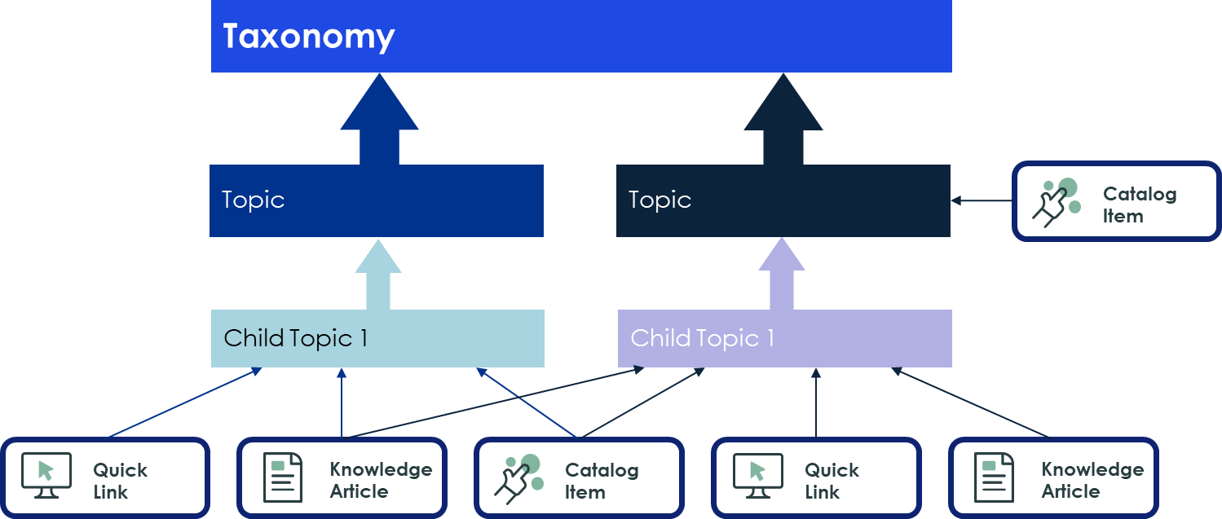
Connecting content to Topics
Connecting content such as CLIENT’S service catalog items and knowledge articles to taxonomy topics will allow users to navigate and find content quicker while on the unified portal.
Service catalog items, knowledge articles, quick links, published content are considered content within Employee Center
Each content available to user should be mapped to a topic/child topic
Content not mapped to a topic will show when user searches
Individual content can be mapped at the topic or child topic level
One content can be mapped to multiple topics if needed
CLIENT can begin mapping content available for user once the topics and child topics are confirmed with KPMG for development.

Slide 45







Employee Center Taxonomy Roles
These are the roles associated with EC Unified Taxonomy, Content & Topics:
Employee Center Admin | Can manage and configure the Employee Center; has Taxonomy Admin privileges.
Taxonomy Admin | Can update and modify any created taxonomy in the taxonomy and topic tables. Can add/edit Taxonomy Manager and Contributor.
Taxonomy Manager | Can view any created taxonomy, update topics and associate content to topics. Can assign Taxonomy Contributors.
Taxonomy Contributor | Can associate content items to topics.
Content Manager | Can access all Content Publishing content, including content for which they are not in the audience.
Topic Manager | Can create, move, or clone topics within or between taxonomies, depending on the rights assigned to them.
Topic Contributor | Can manage topic level tasks, such as handling connected content, features content, articles, adding applications, and so on.
CLIENT will need to provide who in the organization will assume these roles to allow the management of taxonomy, topics and content on the EC Portal.

Slide 46
Manager Hub Overview & Features

Slide 47






Manager Hub introduction
Give supervisors the resources they need to become better leaders. ServiceNow’s Manager Hub provides a unified front door for managers to find information, act, and support their teams more effectively.
Service and Support
Proactive Engagement
Development and Growth
Enable effective leaders with curated self-help
A succinct view of the team’s support & journey needs
Get focused signals
Smart help to take action on what’s most urgent or important to support the team
Guide supervisors to support the development needs of employees
Foster their own continuous growth
Notes:
Provides a one place for people leader on EC portal to manage their teams, allowing them to see what’s going on with their teams, take actions and provide guidance on how to help them grow their team.

Slide 48
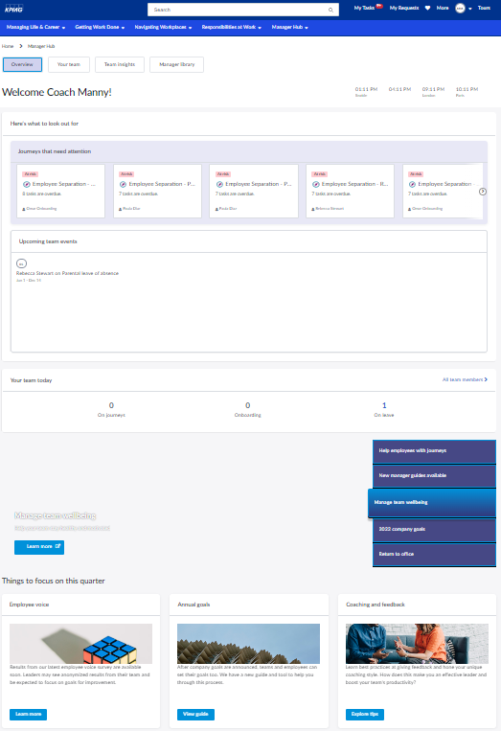
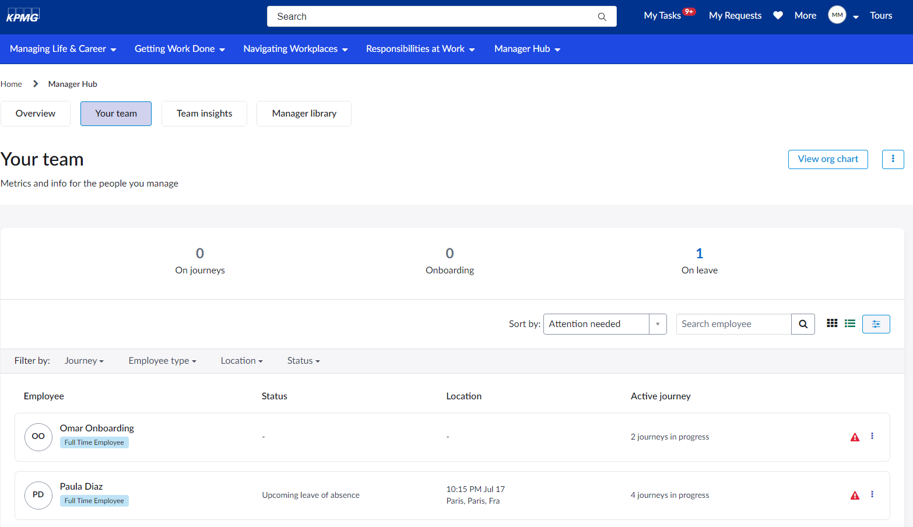
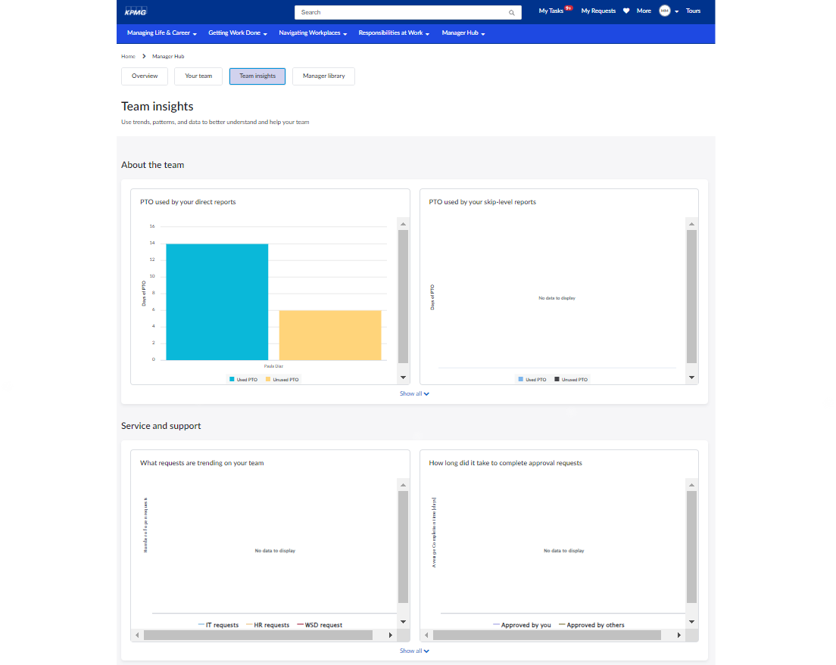
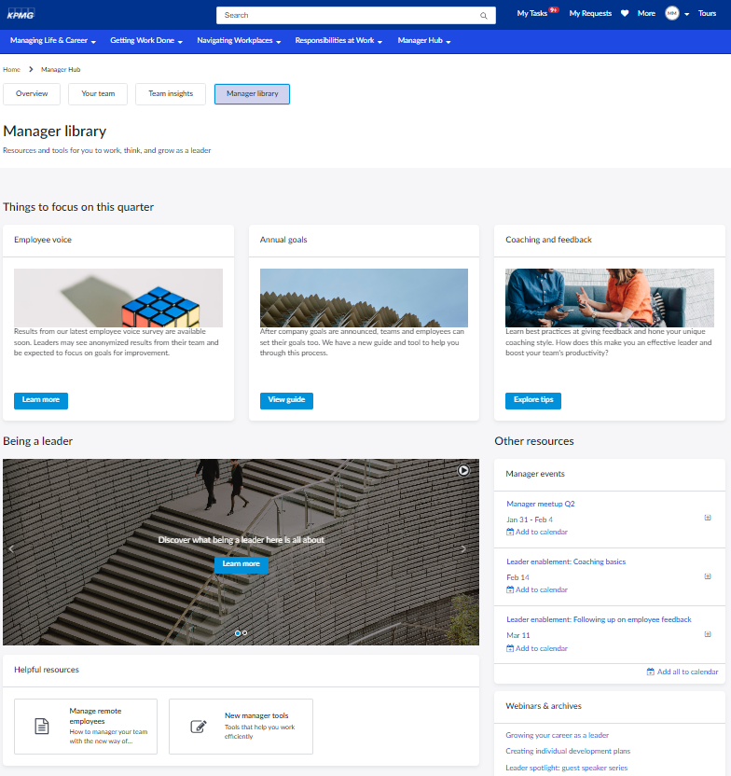
Manager Hub menu items
Manager Hub provides a variety of menu items to support the supervisor experience. These tabs enable supervisors with important information to engage or support their team.
Overview
Your team
Team insights
Manager library
Landing page of the Manager Hub that displays upcoming team events, requests opened by their teams, and items that need attention, etc.
Provides information to leaders on individual team member so that they can better manage their teams.
Provides trends, patterns, and data to better understand and help supervisors manage their team.
Provides resources and tools for managers to work, think, and grow as a leader.
Send as part of workshop pre-read. Ask client to review Manager Hub educational slides and come prepared to give input about requirements.
Notes:
OOTB Manager Hub offers 4 different menu items/tabs and each of these tab offer up information that are relevant for anyone in a manager role with a specific focus. This slide shows at a high level what these focuses are.

Slide 49
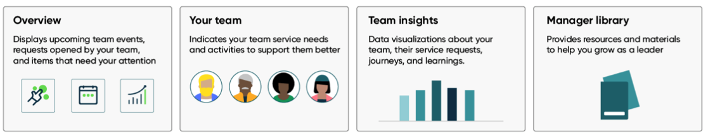
Manager Hub Tabs Exercise
CLIENT Decision
KPMG Recommendation
Activity: Determine which features to display on Manager Hub
Manager Hub Tab | Display on Manager Hub? YES or NO
Overview
Your Team
Team Insights
Manager Library

Slide 50
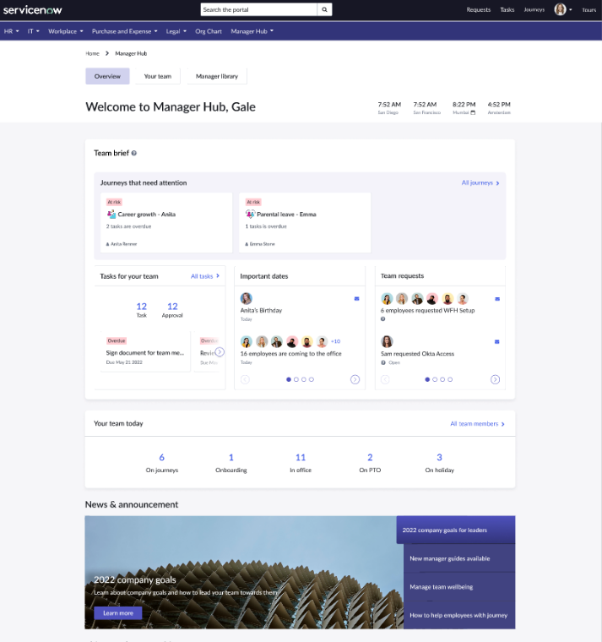
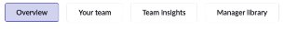
Overview tab
Overview
Your team
Team insights
Manager library
The Overview tab is the default landing page for managers to explore Manager Hub:
Team brief section containing employee journeys, important dates, and upcoming team events, as well as requests owned by the team
See local times and holiday status for multiple locations across a global team​
Your team today provides summary stats for the team, and links to the Your team page​
News & announcements highlight relevant organizational communications for people managers
2
1
Send as part of workshop pre-read. Ask client to review Manager Hub educational slides and come prepared to give input about requirements.
3
4

Slide 51
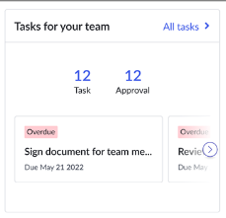
Overview tab cont.
Overview
Your team
Team insights
Manager library
Your management tasks
Supervisors can view and take action on tasks assigned to them, including approvals, HR tasks, and Journey tasks.
Tasks will display in the Your Management tasks widget on the Overview tab.
2
1
3
4

Slide 52
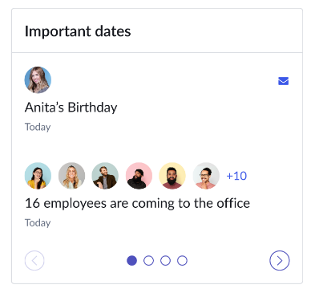
Overview tab cont.
Overview
Your team
Team insights
Manager library
Important dates
Managers can keep track of significant events like employee leaves or recurring milestones such as work anniversaries and birthdays.
Dates will display in the Upcoming team events widget on the Overview tab.
2
1
3
4

Slide 53
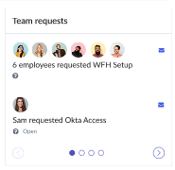
Overview tab cont.
Overview
Your team
Team insights
Manager library
Team requests
This allows manager to be informed of any support requests their team has that they may want to be aware of, even if no specific approval or task has been assigned to them.
Manager must also have the required roles and permissions to view certain team requests. For example, if there are any open requests related to HR cases, then the logged-in manager must also have the sn_hr_core.case_reader role to view those requests.
Team requests are shown in the Requests opened by your team widget on the Overview tab.
2
1
3
4

Slide 54
Overview Tab Features
CLIENT Decision
KPMG Recommendation
Activity: Determine which features to display on the Overview Tab
Team Brief
Employee important dates, and upcoming team events, as well as requests owned by the team
Local Times
See local times and holiday status for multiple locations across a global team
Team Today
summary stats for the team, and links to the Your team page
News & Announcements
Highlight relevant organizational communications for people managers
Management Tasks
View and take action on tasks assigned to them, including approvals, HR tasks, and Journey tasks
Important Dates
Significant events like employee leaves or recurring milestones such as work anniversaries and birthdays
Overview Tab Features | Display on Overview Tab? YES or NO
Team Brief
Local Times
Team Today
News & Announcements
Management Tasks
Important Dates

Slide 55
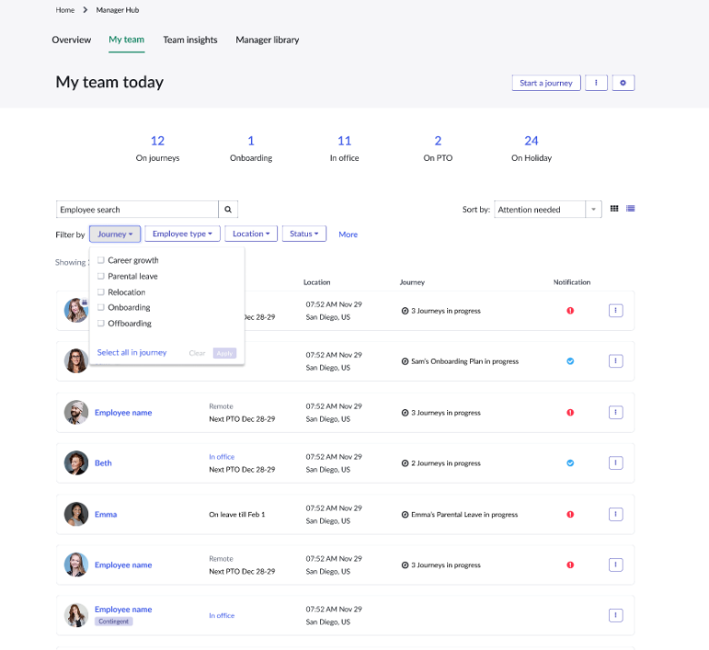
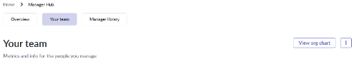
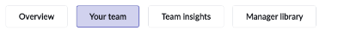
Your team tab
Overview
Your team
Team insights
Manager library
Manager can view details for individual team members, see notifications for activities or requests that need attention, and take common actions for their direct reports.
Your team data and actions
View the org chart and email the team
Employee data
Alerts for the individual from the team brief
Quick action menu
Managers can select from multiple viewing options
List or grid display of the team list
Filtering & sorting for direct reports
Option to view one skip-level of reporting employees
Send as part of workshop pre-read. Ask client to review Manager Hub educational slides and come prepared to give input about requirements.

Slide 56
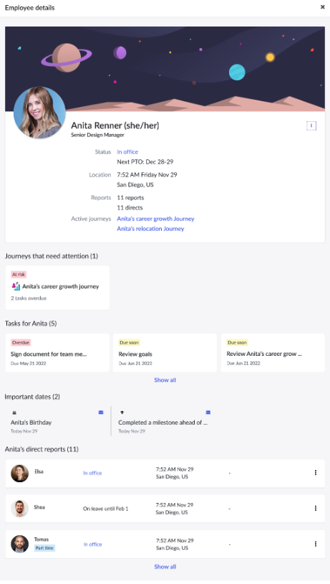
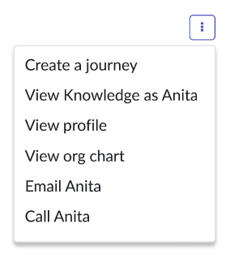
Your team tab cont.
Overview
Your team
Team insights
Manager library
Employee details
Select an employee from the list on the Your team tab to view specific information for that individual
Title
Status
Location
Journeys, Tasks, and Important dates
Direct reports
Click on the menu for additional actions
View profile
View knowledge as the employee
Email or call
Etc.

Slide 57
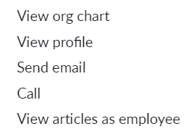
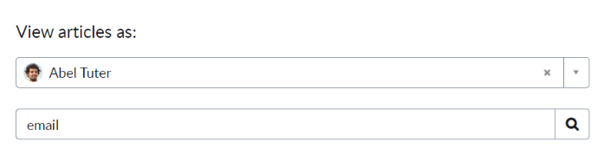
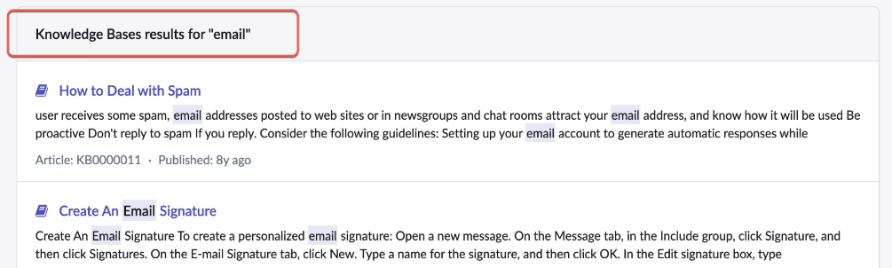
Your team tab cont.
Overview
Your team
Team insights
Manager library
View Knowledge as employee
A manager can search and view the knowledge articles as their team members to provide support or validate the information.
In the action menu, select View articles as employee option.
The search display shows the employee’s name and a search box for the manager to enter keywords.
The results are displayed and can be selected for viewing.
Note: Managers cannot edit or comment on the article.

Slide 58



Your team tab cont.
Overview
Your team
Team insights
Manager library
Your team tab
Team daily stats
Your team today widget shows summary counts for defined activities for the team.
Click on the count to filter the employee list on the Your team tab.
The All team members link on the Overview tab takes the manager to the Your team page.
By default, the following stats are available when Manager Hub is activated.
On journeys
Onboarding
On PTO
On leave
Overview tab

Slide 59
Your Team Tab Features
Reyes Decision
KPMG Recommendation
Activity: Determine which features to display on Your Team tab
Employee Details
View specific information for that individual
Title
Status
Location
Tasks, and Important dates
Direct reports
Employee Knowledge View
A manager can search and view the knowledge articles as their team members to provide support or validate the information.
Team Daily Stats
Stats are available when Manager Hub is activated
Onboarding
On journeys
On PTO
On leave
Your Team Tab Features | Display on Manager Hub? YES or NO
Employee Details
Employee Knowledge View
Team Daily Stats

Slide 60

Team insights tab
Overview
Your team
Team insights
Manager library
The Team insights tab provides managers with historical trends and metrics about their employees’ needs and activities.
Actionable tips and data visualizations help managers continuously improve how they lead and support their teams.
The page is divided into sections that can be configured to show desired reports or Performance Analytics widgets. Default sections include:
About the team: view employee leaves and tenure
Service and support: see counts and types of requests
Employee journeys: status of journeys
Learning and growth: status of assigned courses
Send as part of workshop pre-read. Ask client to review Manager Hub educational slides and come prepared to give input about requirements.

Slide 61

Team insights tab cont.
Overview
Your team
Team insights
Manager library
Insights-based suggestion (Proactive Prompts)
Proactive Prompts can be used to drive positive leadership behaviors among managers in a way that is:
Contextual
Data-driven
Easily-accessible
Surface insights and suggested actions on Manager Hub
Team insights widget can be configured to display the following:
Suggestion categories
Number of prompts
Reports or PA widgets

Slide 62
Team Insights Tab Features
Reyes Decision
KPMG Recommendation
Activity: Determine which features to display on the Team Insights tab
About the Team
Team Insights page is divided into sections that can be configured to show desired reports or Performance Analytics widgets. Default sections include:
About the team: view employee leaves and tenure
Service & Support
Team Insights page is divided into sections that can be configured to show desired reports or Performance Analytics widgets. Default sections include:
Service and support: See counts and types of requests
Performance Analytics & Reports
Use out of box reports to track team work, progress, status, etc.
Team Insights Tab Features | Display on Manager Hub? YES or NO
About Team
Service & Support
Performance Analytics
Reports

Slide 63

Manager library tab
Overview
Your team
Team insights
Manager library
Manager library tab provides a curated and personalized experience for leadership-related content, resources, and tools, such as:
Seasonal activities, such as performance reviews
Corporate projects and initiatives
Hiring policies and enablement
Training and career development
Upcoming manager events
Use Content Publishing to create banners, add videos, and events.
Use Content Experiences for campaign content.
A default Manager library campaign with sample content is included.
Send as part of workshop pre-read. Ask client to review Manager Hub educational slides and come prepared to give input about requirements.

Slide 64
Manager Library
Activity: Determine which features to display on the Manager Library tab
Manager library provides a curated and personalized experience for leadership-related content, resources, and tools, such as:
Seasonal activities, such as performance reviews
Corporate projects and initiatives
Hiring policies and enablement
Training and career development
Upcoming manager events
Use Content Publishing to create banners, add videos, and events
Manager Hub Feature | Display on Manager Hub? YES or NO
Manager Library

Slide 65




Manager Hub roles
Admin
Manager Hub Admin
Manager Hub Content Manager
Manager Hub User
Activates and runs the scheduled job that assigns Manager Hub roles to new people managers
Configures components in Manager Hub
Can manually assign roles, can activate and run the roles scheduled job
Customizes text displayed in widgets
Can view Manager Hub content (such as team data, team requests, etc.)
View information about their direct reports in the Manager Hub on my chevron portal
Notes:
Roles in ServiceNow related to Manager Hub, we don’t need to go super deep now, but we will cross this road where we will need decisions on who will have which roles.

Slide 66
Naming Manager Hub
Activity: Use the below link to submit your response. Consider names or phrases that would resonate with managers.
Below are some ideas for our Manager Hub name:
manager hub / workspace
supervisor hub / workspace
people leader hub / workspace
leader hub / workspace
POLL EV QR CODE

Slide 67
Virtual Agent Overview

Slide 68

What is Virtual Agent?
Virtual Agent is a chatbot solution that can be used to resolve common requests and increase customer satisfaction through an alternative channel of choice for workers.
User responsive, always available
Allow users to self-serve common issues and tasks
Automated familiar messaging interface
Searchable topics
Conversation workflow sitting behind each topic
Live agent hand off
Users can interact with a Virtual Agent via the Now Mobile app (not in scope for this project)
Can integrate with Slack, Microsoft Teams & Workplace by Facebook
Custom chat integrations
Notes:
A pathway to interacting with HR
A pathway to automating familiar messaging
A pathway to searching topics
A pathway to conversational workflow
A pathway to a Service Center employees
A pathway to understanding employee inquiries through natural language understanding (NLU). The assistant can understand local dialect, terminology, slang, abbreviations, etc.

Slide 69

Virtual Agent Workflow
06
Anything Else
08
Displays a message to the user when the bot cannot find a topic (intent) that matches a user request or when it does not understand a user entry.
Closing
Presents an ending message to the user when the conversation is done.
02
04
Virtual Agent Capabilities
Live Agent
Enables users to request a live agent and view items that a live agent can assist with.
Enables users to ask for assistance during the conversation and view a list of items that the bot can assist with.
Supports Natural Language Understanding if enabled.
07
05
VA Feedback
Error Handling
Enables users to provide feedback on their conversational experience, before the conversation ends.
03
Displays an error message to the user when the virtual agent encounters a problem that it cannot resolve.
01
Fallback
Greeting
Asks users if they want to continue with another request or task.
Presents various greetings to the user at the beginning of a conversation.

Slide 70





Greeting message (Option 1)
Proposed Greeting Message 1
IT
HR
[Privacy Notice]
Hi Alex. What can I help you with today?
You can type your request below or select the options available.
IT
HR
If IT
Thank you for contacting the Global IT Service Desk. Click Here to see the current Major/Master IT incidents reported.
Please type your request below or select the options available.
IT Self Service
IT Issues
Show me everything >
If HR
Please type your request below or select the options available.
Chat with HR
Local HR Policies
Performance Management
Show me everything >
Notes:
Discussion: Add privacy notice to the top
CLIENT can introduce you to our data privacy person to review any proposed statement changes
Option 1 to move forward

Slide 71
Greeting message (Option 2)
IT
HR
Proposed Greeting Message 2
[Privacy Notice]
Hi Alex.
Thank you for contacting [chat name]. Click Here to see the current Major/Master IT incidents reported.
You can type your request below or select the options available.
IT Self Service
IT Issues
Local HR Policies
Performance Management
Show me everything >
If Show me everything*
Topic
Topic
Topic
Topic
Etc.
*Show me everything option will show both HR and IT topics available in VA.

Slide 72


Virtual Agent feedback
IT
HR
We recommend to align how Virtual Agent currently collect feedback from users to unify the overall experience.
Visual vs. text
5-point scale vs. 3-point scale
When it comes to Virtual Agent chat, our recommendation is to stick with a simpler, 3-point Likert scale with visuals to engage the user and collect quick feedback.
Rating options: Good, Neutral, Bad
Notes:
Good to move forward with icons with 3 likert scale
2 options even better - Useful (happy face) - not Useful (frowny face)

Slide 73



Support options menu
IT
HR
Currently the Support options menu does not present information on other support channels such as:
If CLIENT decides to include these options, below are some considerations:
Contact Live Agent – can’t have multiple live chats
Send Email – can only support one email
Call Support – link to knowledge article to direct user to different numbers as needed
Notes:
No need to configure

Slide 74
Virtual Assistane Chat Window Name Exercise
Activity: Use the below link to submit your response. Consider names or phrases that would resonate with employees.
Below are some considerations when picking a name for your chat window:
Keep it simple – choose something that is easy to pronounce and spell
Be descriptive – name should reflect purpose and function the virtual agent.
Stay consistent with branding – use the same naming conventions and brand guidelines to stay consistent across platforms
Know your audience – pick something that would resonate with your user (stick with the critical mass)
Keep it short & catchy – pick something short and catchy to help user remember
Some potential candidates:
Ask Bot
My Virtual Agent
CLIENT Virtual Agent (final)
IT
HR

Slide 75
Guided Tours

Slide 76

Guided Tours Overview
Train users with built‑in guidance and visual cues that show employees how to use any form, application, or portal. Empower users with integrated self‑help guidance to reduce support requests and accelerate productivity within your organization.
Outcomes
Drive user learning and ensure adoption
Provide guidance to users when and where they need it
Drive productivity with on-demand tours that help users complete goal-oriented tasks and maximize efficiency.
Get insights into where users seek guidance and recognize behavior patterns within user journeys.

Slide 77


Feature Details
Built In Guidance
Create tours to show how to use any form, report, app, or Service Portal. Step‑by‑step prompts provide real‑time guidance for quick onboarding. With less time spent learning how to employ forms, reports, and apps, users spend more time being productive.
Role Based Tours
Design purposeful role‑based training by defining tours associated with a specific role, or selection of roles.
On-Demand Guidance
Access tours on‑demand for real‑time help when you need it.
Auto-Launch Tours
Guided tour administrators may choose to make certain tours mandatory, so they’re auto‑launched the first time a user visits a page.
Tour Insights
Get detailed tour analytics to learn where users seek help, what tours are most popular, and which tours get skipped.
Guided Tours Overview

Slide 78


Feature Details
User Engagement
Shows the number of users actively working with Guided Tours and trends over time.
View reports for:
Tour Views
Tours Completed
Unique User Views
Unique User Completions
Daily Engagement
Disengaged Users
Tour Statistics
Shows trends and patterns for user engagement so you can analyze tour completions and tour failures and build more successful tours.
View reports for:
Tour Failures
Top 10 Tour Completions
Top 10 Tour Failures
Top 10 Tour Dismissals
Guided Tours Dashboard
The Guided Tours Overview dashboard provides statistics related to guided tour usage. View metrics for User Engagement and Tour Statistics.
Notes:
Guided Tours dashboard (servicenow.com)

Slide 79
Guided Tour Components
Component | Description
Introduction | Shows an introductory message to your users.
Step | A discrete component of a guided tour that implies an order. A step can provide a definition, an instruction, or both.
Callout | Shows the definition and instruction about the current step in the tour. The callout includes the instruction to proceed to the next step. It points to the element that the instruction describes.
Element | The objects that the tour points to, such as a record in the database, or a widget on a page. Elements require formatting so that the tour can link to them.
Trigger | Moves the tour to the next step. Triggers include pressing the Enter key, clicking or right-clicking a UI element, or clicking a Next button in the callout.
Conclusion | Shows a closing message to your users at the end of the guided tour.

Slide 80
Guided Tour Example: Homepage Overview
Step | Callout | Trigger
Intro | Title: Service Portal Overview Text: Welcome to this guided tour of your new Service Portal home page. | Next button
1 | Points to this element: How can we help? Placement: Below Text: We begin with the How can we help? search bar. If you cannot find what you are looking for, enter it here, click the Search icon, or press Enter on your keyboard. For now we will take a look at some other areas first. | Next button
2 | Points to this element: Order Something Placement: Top Text: If you would like to order something, such as a new phone, select Order Something. | Next button
3 | Points to this element: Knowledge Base Placement: Top Text: If you would like to search the knowledge base, select Knowledge Base. | Next button
4 | Points to this element: Get Help Placement: Top Text: If you would like to get help for an issue, select Get Help. | Next button
5 | Points to this element: Community Placement: Top Text: If you would like to ask your colleagues a question, select Community. | Next button
6 | Points to this element: Knowledge in title bar Placement: Left Text: You can also check the knowledge base, order something, look at requests you have logged, and check other options up here in the title bar. | Next button
7 | Points to this element: Your name Placement: Left Text: View your profile or log out by clicking your name. | Next button

Slide 81
Content Publishing

Slide 82
Supporting Resources

Slide 83
Employee Center Widgets
Widgets | Benefits | Roles/User Criteria
Curated Experiences​ | Provides dynamic employee-centric browse experience based on a unified taxonomy across all content types:​Employee Taxonomy: The base system employee-centric taxonomy that organizations can use as a starting point.​ Advanced portal navigation: You can configure the mega menu to show a mixed hierarchy of SP menu items, APN menu items, and topics with flexible layout options. Mega Menu Widget: The top navigation bar for employees to browse all available topics.​ Popular Topics Widget: The most popular topics highlighted across all organizations.​ Dynamic Topic Pages: The dedicated and dynamically created page for accessing all content associated with the topic.​ | admin
Employee Profile Page | Provides the employee-centric taxonomy that organizations can use as a starting point. | sn_employee.admin
Favorites Page​ | Provides quick access to all favorite items.Opens in a separate page, where you can manage all your favorite content. | admin
Footer Widget​ | Allows for more scalability and configuration options. | admin, sp_admin
Modern Portal Theme​ | Provides consistency across all the portal pages.​ | admin
My Active Items Widget​ | Provides a consolidated view into all the tasks and to-dos assigned to the employee.It is designed to be configured and extended to additional tasks.​ | admin, sp_admin, esc_admin
Quick Links Widget | Provides quick access to all the important content and pages (internal and external). | sp_admin, user_criteria_admin, Taxonomy Manager
Recommended for you widget | Highlights the most relevant content for the employee.It is based on popularity or ML-algorithm (if entitled for Predictive Intelligence capabilities) that looks at similarity in employee profile to show popular content. | admin, sp_admin
Video Carousel widget | Shows the video content on the portal. Multiple videos show in a carousel. You can show a scrolling list of videos using this widget.Note: Only YouTube and Vimeo embedded links are supported. | admin

Slide 84
Employee Center PRO Widgets
Widget | ID | Description
App Launcher | app-launcher | Appears on the home page to provide one-click access to recently-used applications and favorites.
Organization Chart (EC) | org_chart | Displays the employees organization chart, the relationships to other employees, and more.
Web Applications | web_applications | Provides one-click access to applications assigned to the user.

Slide 85
Content Publishing & Content Experience Widgets
Widget | ID | Description
Announcements (CD) | cd-announcements | Shows portal content with content type of Rich Text. Generally, a brief broadcast message and shows in a carousel when there are multiple items.
Category News Feed | cd-news-feed-category | Shows previews of news articles for a specific category.
Content Experience | cd-content-experience | Delivers targeted, actionable communications to employees. For more information, see Campaigns for Content Experiences.
Content To-do (CD) | cd-content-todo | This widget is part of the HR to-do completion process used in the Employee Service Center, but cannot be used as a standalone widget.
Event Calendar (CD) | cd-event-calendar | Shows portal content with content type of Calendar. Shows schedules.
Featured News | cd-news-featured | Shows highlighted articles at the top of the News Center.
Information Links (CD) | cd-information-links | Shows portal content with content type of URL. Shows hyperlinks.
News Article Detail | cd-news-article-detail | Appears on the Article details page and holds the article body as created in the Rich Content Editor.
News Dataloader | cd-news-dataloader | Can be added to the Article details page to facilitate data sharing between the widgets on the page, which reduces the page loading time.
News Feed | cd-news-feed | Appears on the home page, News Center, and article details pages and holds previews of news articles.
News Header | cd-news-header | Appears on the Article details page and holds the headline, subheadline and image thumbnail.

Slide 86
Content Publishing & Content Experience Widgets
Widget | ID | Description
News Info | cd-news-info | Appears on the Article details page and holds the news article publication date and Copy Link button.
Organization Chart (CD) | cd-orgchart | Shows an organization chart of an employee.
Preview Mobile Content (CD) | cd-preview-mobile-content | Notifications that show up in mobile view.
Preview of Content To-do (CD) | preview_content_todos | Shows a preview of to-do content.
Quick Links (CD) | cd-quick-links | Shows portal content with content type of Image-based Link. Shows a row of clickable images.
Rich Content (CD) | cd-richcontent | Shows previews of three pieces of rich content. Appears as a carousel when are there more than three published pieces of rich content.
Styled Content (CD) | cd-styled-content | Shows portal content with content type of Styled Content. Shows informative banners or text.You can configure color, alignment, and other options for text and background. Appears as a carousel when there are multiple items.
Upcoming Events (CD) | cd-upcoming-events | Shows portal content with content type of Event. Shows upcoming events.
Video Carousel (CD) | cd-video-carousel | Shows portal content with content type of Video. Multiple videos show in a carousel. You can show a scrolling list of videos using this widget.Note: Only YouTube and Vimeo embedded links are supported.
Welcome Banner (CD) | cd-banner | Shows portal content with content type of Banner. Generally used to show informative banners/text. Shows in a carousel when there are multiple items.

Slide 87

Sample 4
LOGO
LOGO
Company Championship
Mental Health Resources
Industry Resources
We’re proud to be the title sponsor of the Golf Championship, one of five major Ladies Professional Golf Association tournaments.
Company Championship
Mental Health Resources
Industry Resources
We’re proud to be the title sponsor of the Golf Championship, one of five major Ladies Professional Golf Association tournaments.

Slide 88

Sample 5
Company
Company
How Company Bridge Boosts Efficiency, Speed Innovation
Company Signs 7 Year Deal
How Company Bridge Boosts Efficiency, Speed Innovation
Company Signs 7 Year Deal

Slide 89


Sample 6

Slide 90

Sample 7

